Slide 1

TEAM MAJESTY

Slide 2

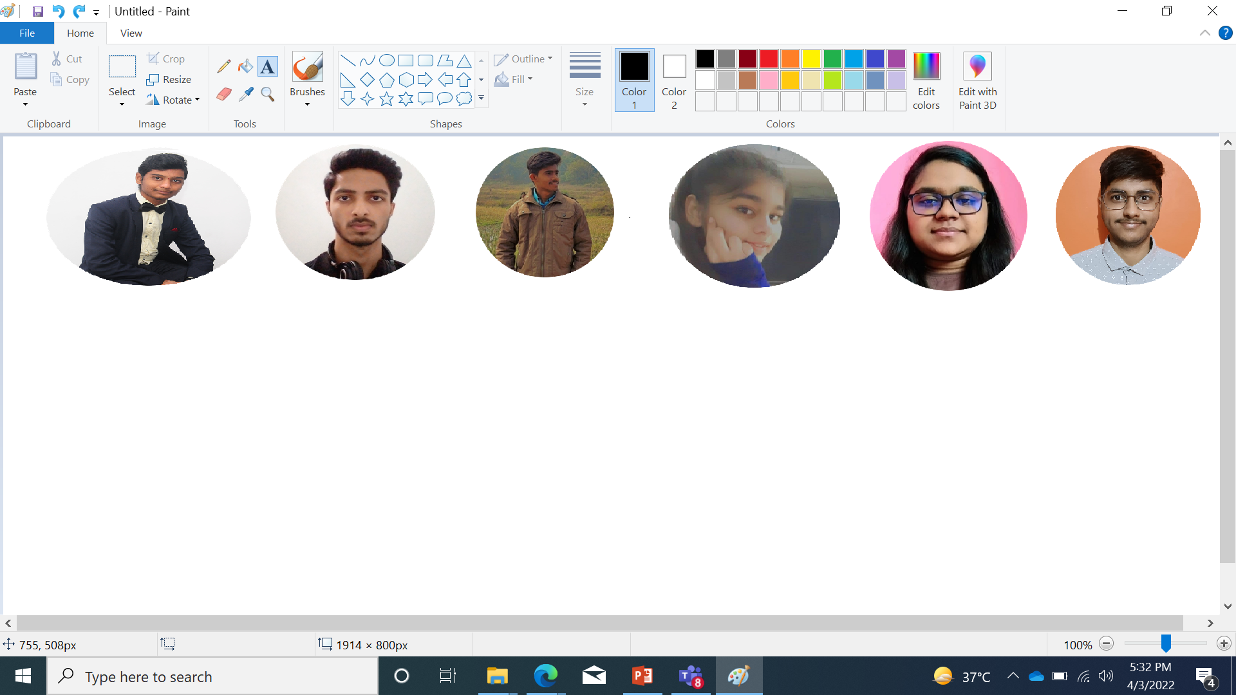
TEAM MAJESTY
Our team consists of six members who have worked really very hard to make this project successful.
Every member plays a significant role in the completion of this project. The member of the group are : K ABHIRAM, TUSHAR PRABHAKAR, ROHIT KUMAR RAY, SHRASTI ARYA, T. SAISHREE & AYUSH VERMA.

Slide 3

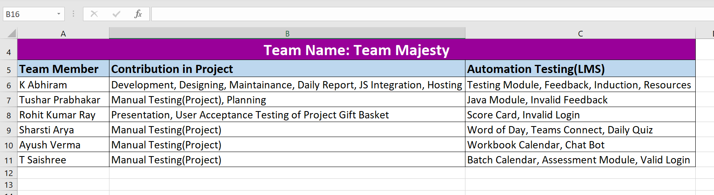

Slide 4
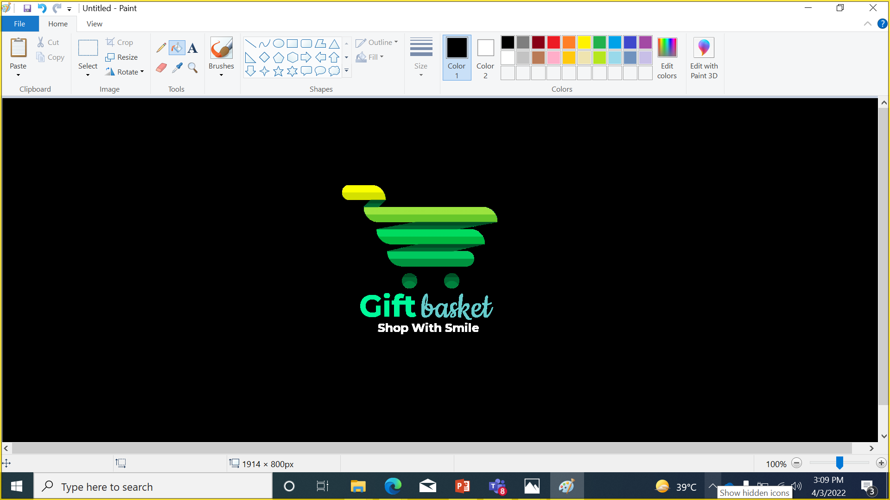
INTRODUCTION
Gift Basket is an online Digital Gift Superstore in India. At Gift basket we provide different customizable gift items for your loved ones. At Gift Basket, anyone can easily customized any Mobile phone Cases, Mugs, T-Shirts, Photo Canvas, Posters, Playing Cards, Badges, Visiting Cards and More gifting items Online within minutes.
The website is designed for the users to help them out to find items which will make them stand out in the crowd with Personalized and Unique products printed specially by them. The Website is very user-friendly and the flow of ordering items is very easy to use. It is an idea derived from the product selling concept of our very own team member K ABHIRAM online store of selling customizable items . We planned to make the items reach at the national level. So, here we (TEAM MAJESTY) present to you our website … GIFT BASKET….
Link for the website : https://abhiramprints.github.io/gift_basket/

Slide 5
HOMEPAGE
NAVIGATION BAR
ABOUT
CATEGORIES
FEEDBACK
CONTACT US
CATEGORIES AVAILABLE
MDF GIFTS
STATIONARY GIFTS
CUSTOMIZED WEARABLES
CUBICLE ESSENTIALS
GET IN TOUCH FORM
ENTER NAME, EMAIL AND MESSAGE
SEND MESSAGE
FIND US HERE
ONLINE STORE ADDRESS
FOOTER
QUICK LINKS
CONTACT DETAILS

Slide 6
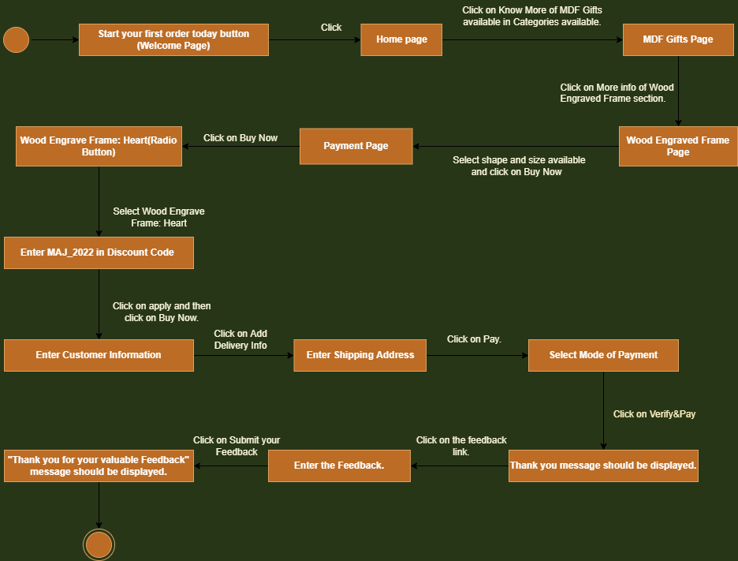

Slide 7
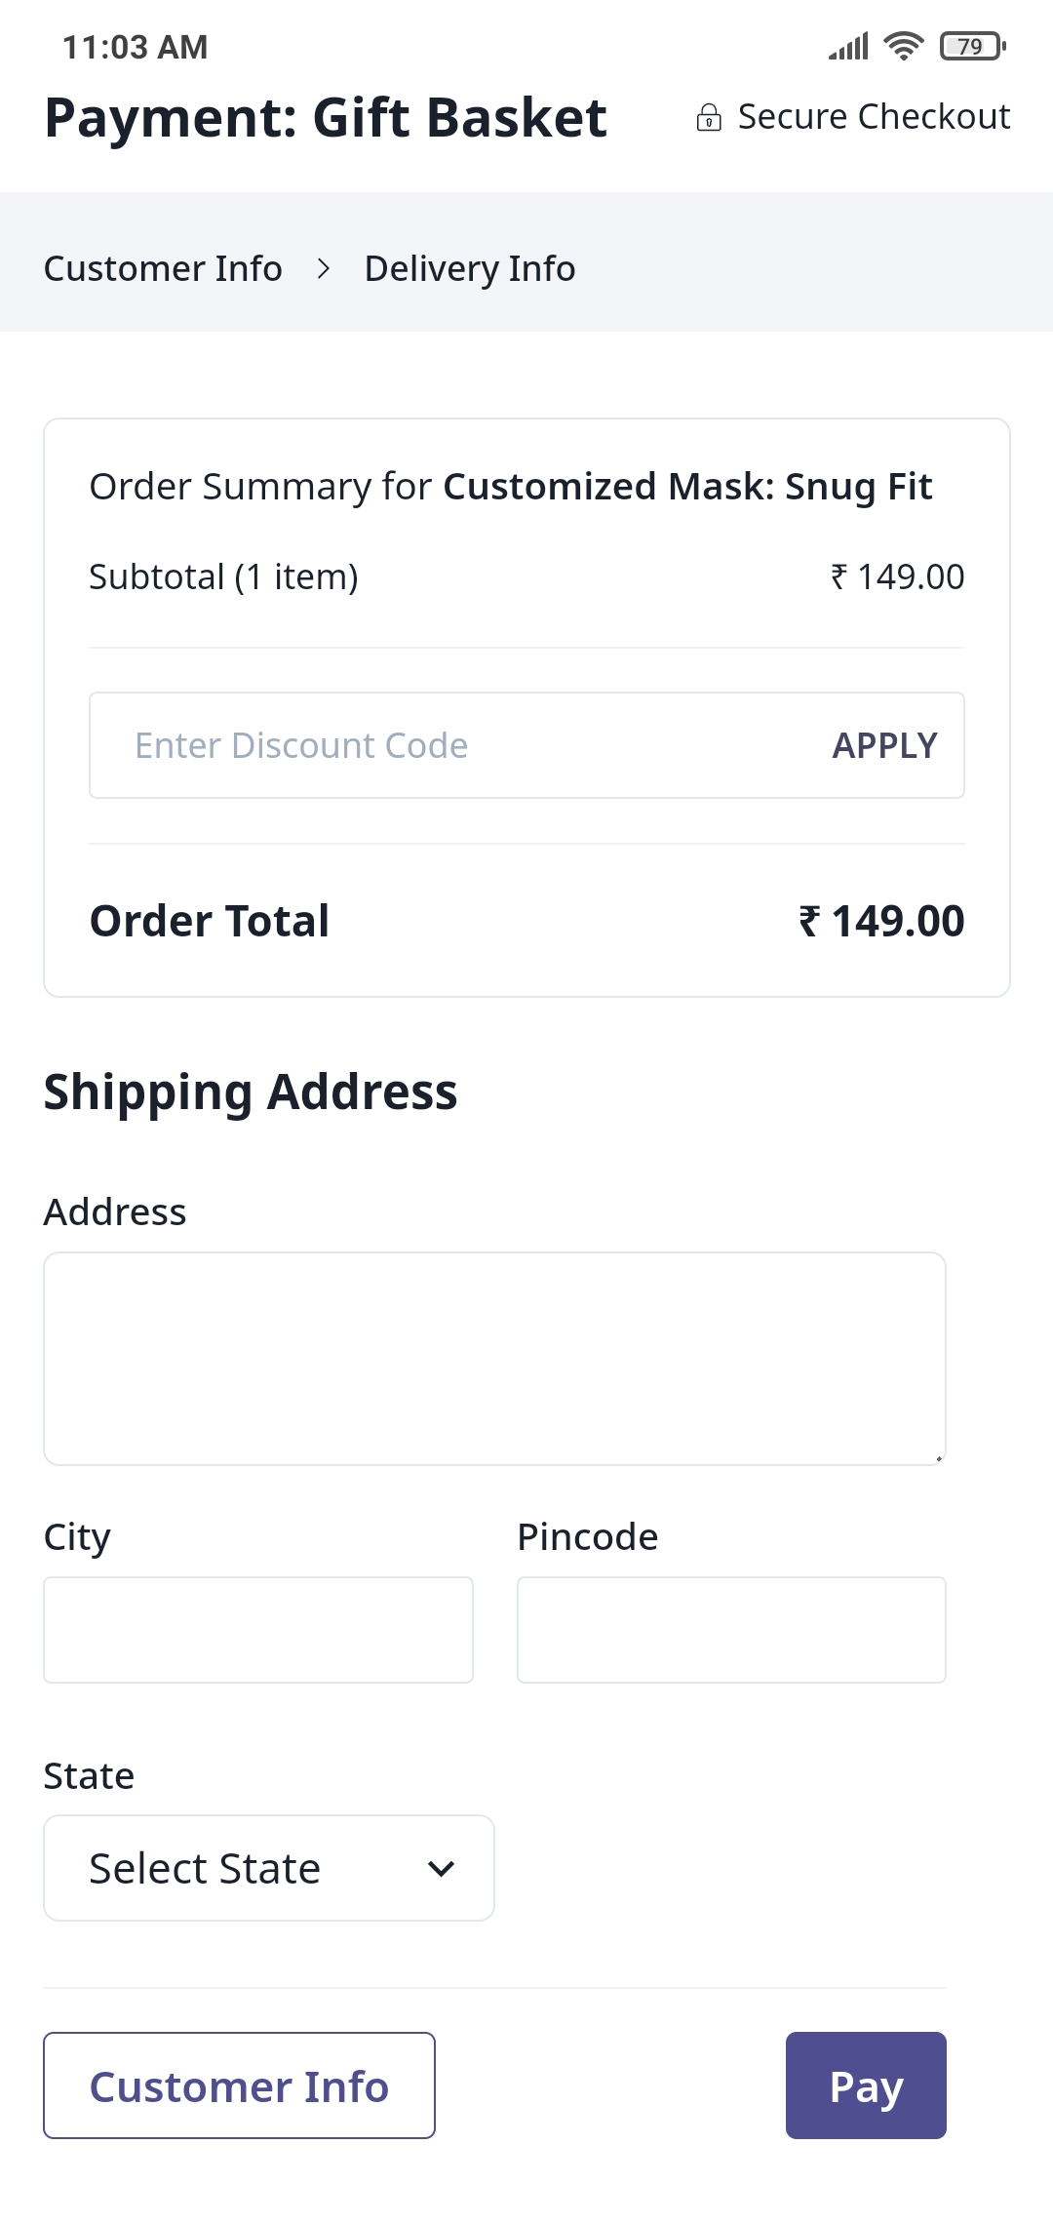
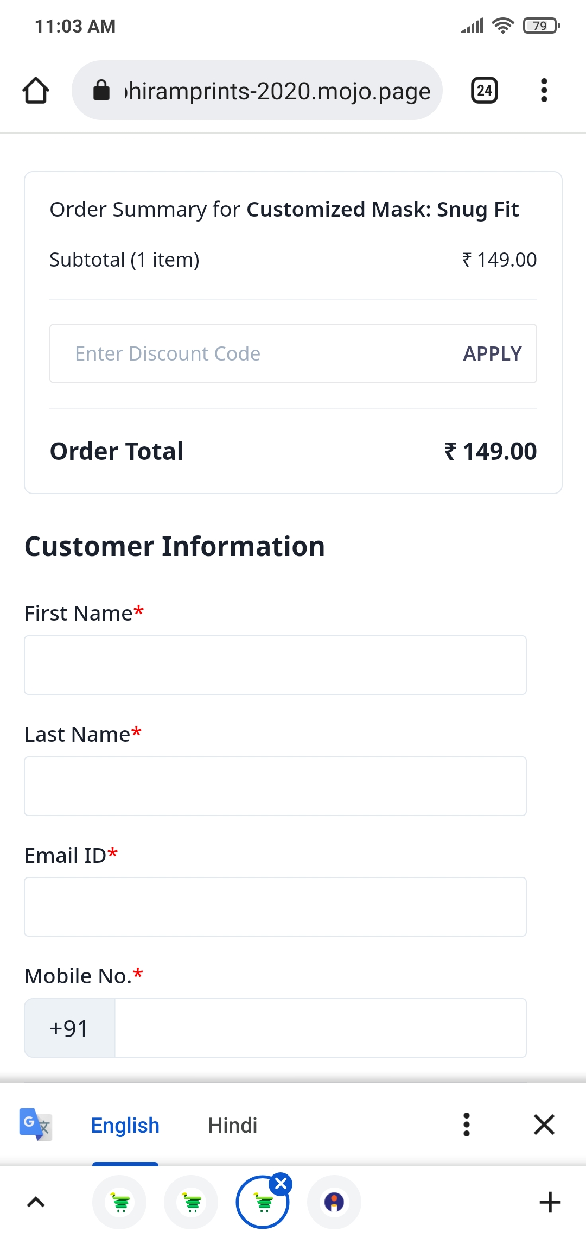
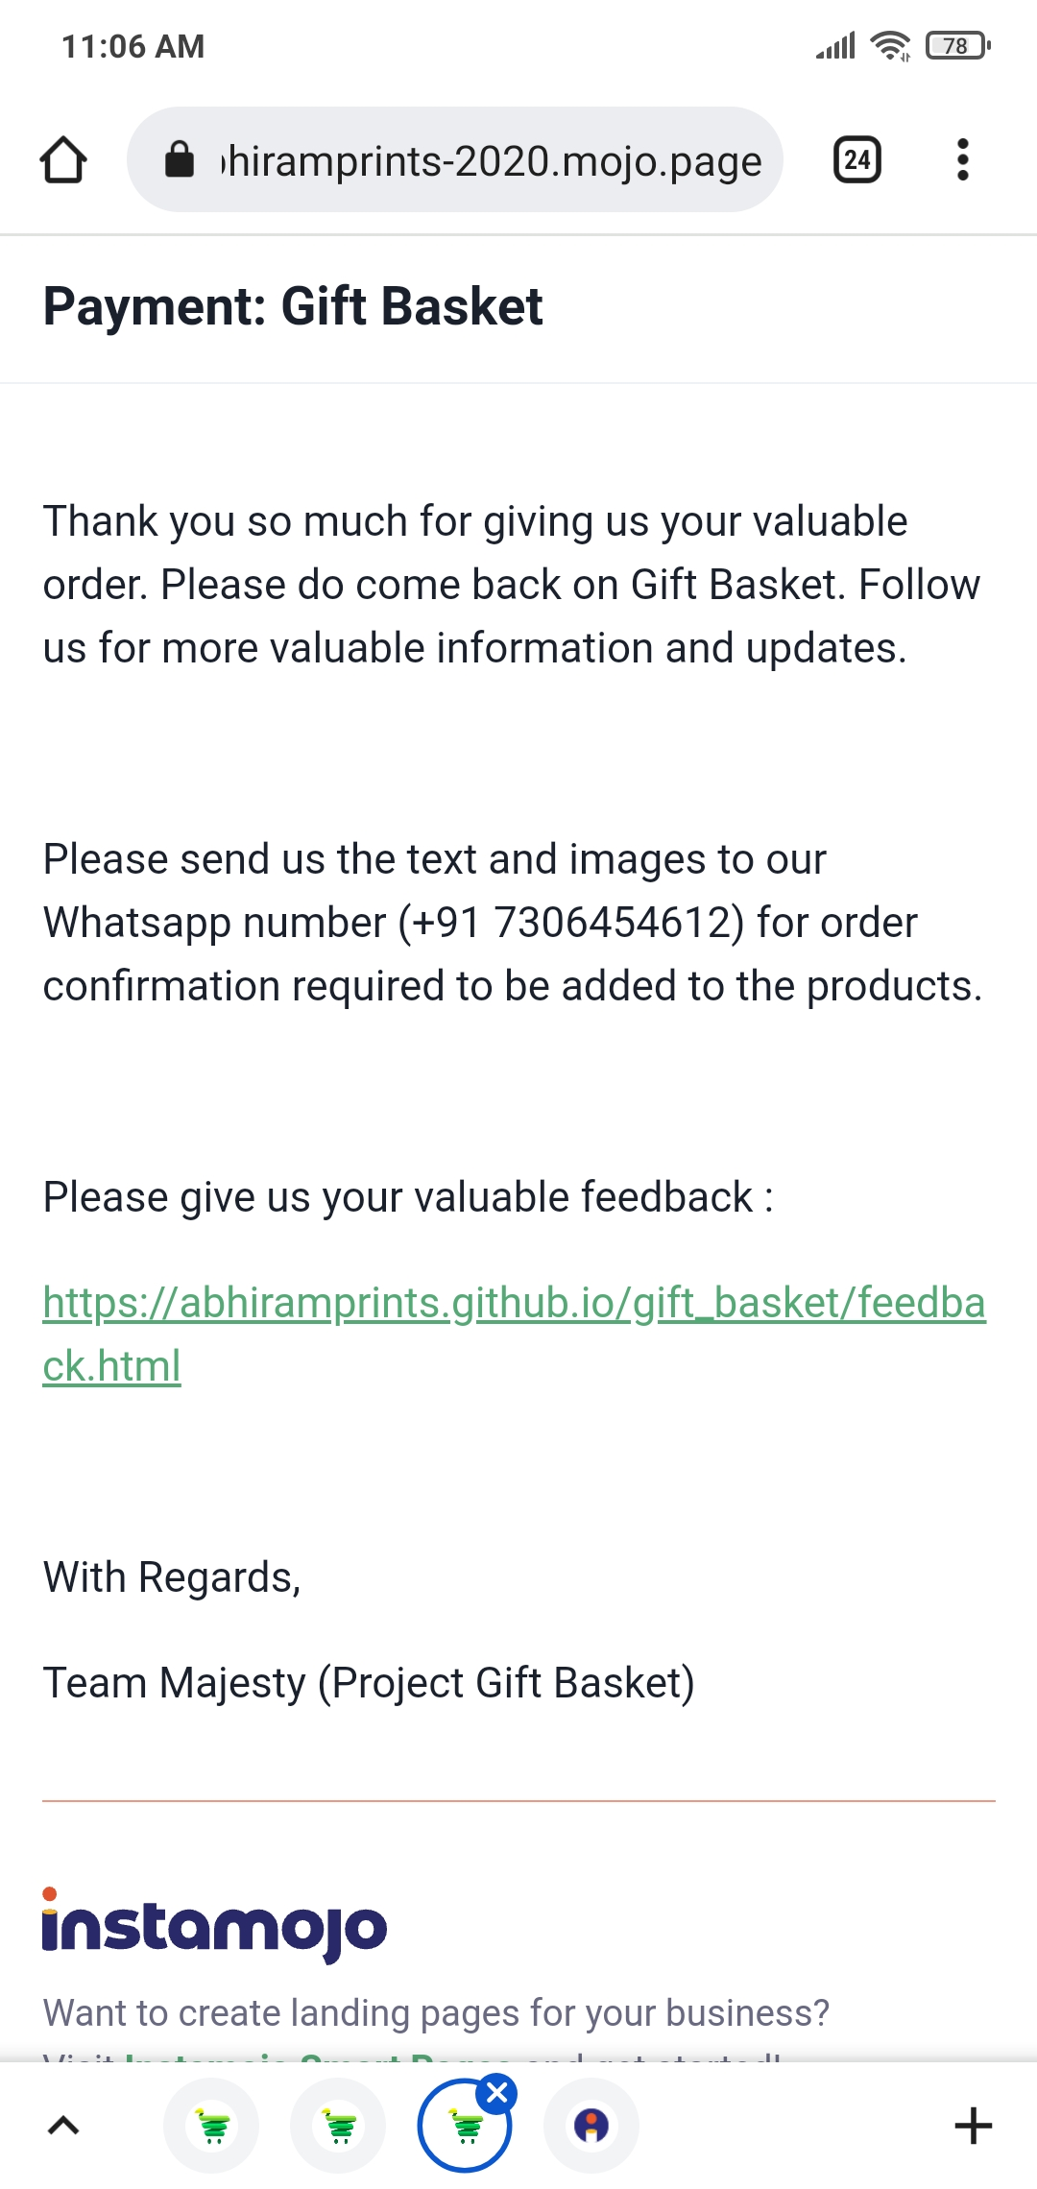
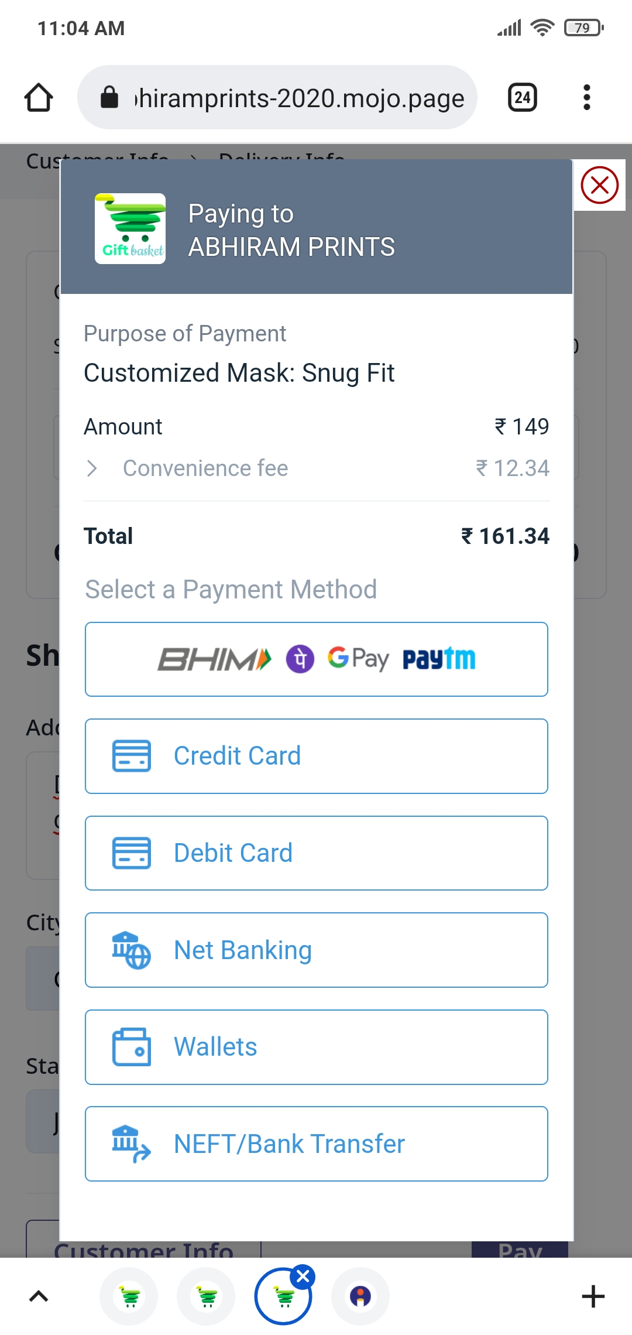
Way to complete the Transaction and order the product from Gift Basket

Slide 8

TESTING
TESTED BY TEAM MAJESTY

Slide 9

REQUIREMENTS SPECIFICATIONS
RO1
FUNCTIONAL DESCRIPTION
RO2
WELCOME PAGE
RO3
HOMEPAGE
RO4
PRODUCT CATALOG PAGE
RO5
PRODUCT DETAILS
RO6
TRANSACTION PAGE
RO7
FEEDBACK

Slide 10
TEST SCENARIOS : GIFT BASKET
SL.NO. | Module | Test Scenario_id | Scenario_name | Requirement_ID
1 | Gift Basket's Complete end-to-end Functionality | GIFT_FUNCTIONAL_1 | Validating Gift Basket's Complete end-to-end working | RO1
2 | Gift Basket's Welcome Page | GIFT_FUNCTIONAL_1 | Validating Welcome page fields | RO2
3 | Gift Basket's Home Page | GIFT_HOME_1 | Validating Home Page's fields | RO3
4 | Gift Basket's Quick Links function | GIFT_QUICK_LINKS_1 | Validating Quick Links function | RO3
5 | Gift Basket's MDF Gifts Page | GIFT_CATG_MDF_1 | Validating MDF Gifts Page's fields | RO4
6 | Gift Basket's Stationery Gifts Page | GIFT_CATG_STA_1 | Validating Stationery Gifts Page's fields | RO4
7 | Gift Basket's Customized Wearables Page | GIFT_CATG_CUST_WEAR_1 | Validating Customized Wearables Page's fields | RO4
8 | Gift Basket's Cubicle Essentials Page | GIFT_CATG_CUBE_ESSEN_1 | Validating Cubicle Essentials Page's fields | RO4
9 | Gift Basket's MDF Gifts Products detail view Page | GIFT_MDF_PROD_DETAIL_1 | Validating MDF Gifts Products detail view Page's fields | RO5
10 | Gift Basket's Stationery Gifts Products detail view Page | GIFT_STA_PROD_DETAIL_1 | Validating Stationery Gifts Products detail view Page's fields | RO5
11 | Gift Basket's Customized Wearables Products detail view Page | GIFT_CUST_WEAR_PROD_DETAIL_1 | Validating Customized Wearables Products detail view Page's fields | RO5
12 | Gift Basket's Cubicle Essentials Products detail view Page | GIFT_CUBE_ESSEN_PROD_DETAIL_1 | Validating Cubicle Essentials Products detail view Page's fields | RO5
13 | Gift Basket's Transaction Page | GIFT_TRANSACTION_1 | Validating Transaction page's info | RO6
14 | Gift Basket's Transaction Page | GIFT_TRANSACTION_2 | Validating Transaction page's info | RO6
15 | Gift Basket's Feedback Page | GIFT_FEEDBACK_1 | Validating Feedback Page's info | RO7
16 | Gift Basket's Feedback Page | GIFT_FEEDBACK_2 | Validating Feedback Page's info | RO7

Slide 11
RTM-GIFT BASKET
Requirement_ID | Test Scenario_ID | Test Case_ID | Test Result
RO1 | GIFT_FUNCTIONAL_1 | GIFT_SIGN IN_TC_1 | Pass
RO2 | GIFT_WELCOME_1 | GIFT_SIGN IN_TC_2 | Pass
RO3 | GIFT_HOME_1 | GIFT_SIGN IN_TC_3 | Pass
 |  | GIFT_SIGN IN_TC_4 | Pass
 |  | GIFT_SIGN IN_TC_5 | Pass
 |  | GIFT_SIGN IN_TC_6 | Pass
 |  | GIFT_SIGN IN_TC_7 | Pass
 |  | GIFT_SIGN IN_TC_8 | Pass
 |  | GIFT_SIGN IN_TC_9 | Pass
 |  | GIFT_SIGN IN_TC_10 | Pass
 |  | GIFT_SIGN IN_TC_11 | Pass
 |  | GIFT_SIGN IN_TC_12 | Pass
 |  | GIFT_SIGN IN_TC_13 | Pass
 |  | GIFT_SIGN IN_TC_14 | Pass
 |  | GIFT_SIGN IN_TC_15 | Pass
 | GIFT_QUICK_LINKS_1 | GIFT_SIGN IN_TC_16 | Pass
 |  | GIFT_SIGN IN_TC_17 | Pass
 |  | GIFT_SIGN IN_TC_18 | Pass
 |  | GIFT_SIGN IN_TC_19 | Pass
 |  | GIFT_SIGN IN_TC_20 | Pass
 |  | GIFT_SIGN IN_TC_21 | Pass
RO4 | GIFT_CATG_MDF_1 | GIFT_SIGN IN_TC_22 | Pass
 |  | GIFT_SIGN IN_TC_23 | Pass
 |  | GIFT_SIGN IN_TC_24 | Pass
 |  | GIFT_SIGN IN_TC_25 | Pass
 | GIFT_CATG_STA_1 | GIFT_SIGN IN_TC_26 | Pass
 |  | GIFT_SIGN IN_TC_27 | Pass
 |  | GIFT_SIGN IN_TC_28 | Pass
 |  | GIFT_SIGN IN_TC_29 | Pass
 | GIFT_CATG_CUST_WEAR_1 | GIFT_SIGN IN_TC_30 | Pass
 |  | GIFT_SIGN IN_TC_31 | Pass
 |  | GIFT_SIGN IN_TC_32 | Pass
 |  | GIFT_SIGN IN_TC_33 | Pass
 | GIFT_CATG_CUBE_ESSEN_1 | GIFT_SIGN IN_TC_34 | Pass
 |  | GIFT_SIGN IN_TC_35 | Pass
 |  | GIFT_SIGN IN_TC_36 | Pass
 |  | GIFT_SIGN IN_TC_37 | Pass
RO5 | GIFT_MDF_PROD_DETAIL_1 | GIFT_SIGN IN_TC_38 | Pass
 |  | GIFT_SIGN IN_TC_39 | Pass
 |  | GIFT_SIGN IN_TC_40 | Pass
 |  | GIFT_SIGN IN_TC_41 | Pass
 | GIFT_STA_PROD_DETAIL_1 | GIFT_SIGN IN_TC_42 | Pass
 |  | GIFT_SIGN IN_TC_43 | Pass
 |  | GIFT_SIGN IN_TC_44 | Pass
 |  | GIFT_SIGN IN_TC_45 | Pass
 | GIFT_CUST_WEAR_PROD_DETAIL_1 | GIFT_SIGN IN_TC_46 | Pass
 |  | GIFT_SIGN IN_TC_47 | Pass
 |  | GIFT_SIGN IN_TC_48 | Pass
 |  | GIFT_SIGN IN_TC_49 | Pass
 | GIFT_CUBE_ESSEN_PROD_DETAIL_1 | GIFT_SIGN IN_TC_50 | Pass
 |  | GIFT_SIGN IN_TC_51 | Pass
 |  | GIFT_SIGN IN_TC_52 | Pass
 |  | GIFT_SIGN IN_TC_53 | Pass
RO6 | GIFT_TRANSACTION_1 | GIFT_SIGN IN_TC_54 | Pass
 |  | GIFT_SIGN IN_TC_55 | Pass
 |  | GIFT_SIGN IN_TC_56 | Pass
 |  | GIFT_SIGN IN_TC_57 | Pass
 | GIFT_TRANSACTION_2 | GIFT_SIGN IN_TC_58 | Pass
 |  | GIFT_SIGN IN_TC_59 | Pass
 |  | GIFT_SIGN IN_TC_60 | Pass
 |  | GIFT_SIGN IN_TC_61 | Pass
RO7 | GIFT_FEEDBACK_1 | GIFT_SIGN IN_TC_62 | Pass
 | GIFT_FEEDBACK_2 | GIFT_SIGN IN_TC_63 | Pass
 |  | GIFT_SIGN IN_TC_64 | Pass
 |  | GIFT_SIGN IN_TC_65 | Pass
 |  | GIFT_SIGN IN_TC_66 | Pass

Slide 12

AUTOMATION TESTING
Cross Browser Testing
Checkpoints
isDisplayed()
isEnabled()
assertEquals()
Proper Error Message
Modularity
Browsers Used
How we generated XML files

Slide 13
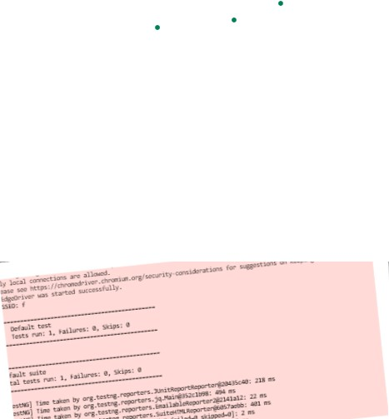
MODULES TESTED IN LMS
Java Module
Testing Module
Daily Quiz
Assessment
Batch Calendar
Scorecard
7. Chatbot
8. Resources
9. Induction
10.Workbook Calendar
11.Valid Login
12.Word Of Day
13.Teams Connect
14.Invalid Login
15.Feedback
16.Invalid Feedback

Slide 14
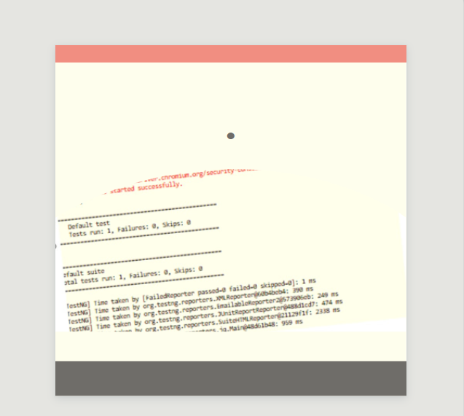
Methods Implemented
SendKeys;
Click();
Drop down();
Thred.sleep();
TestNG
Methods Implemented
sendKeys()
Click()
Drop down()
TestNG
assertEquals()

Slide 15
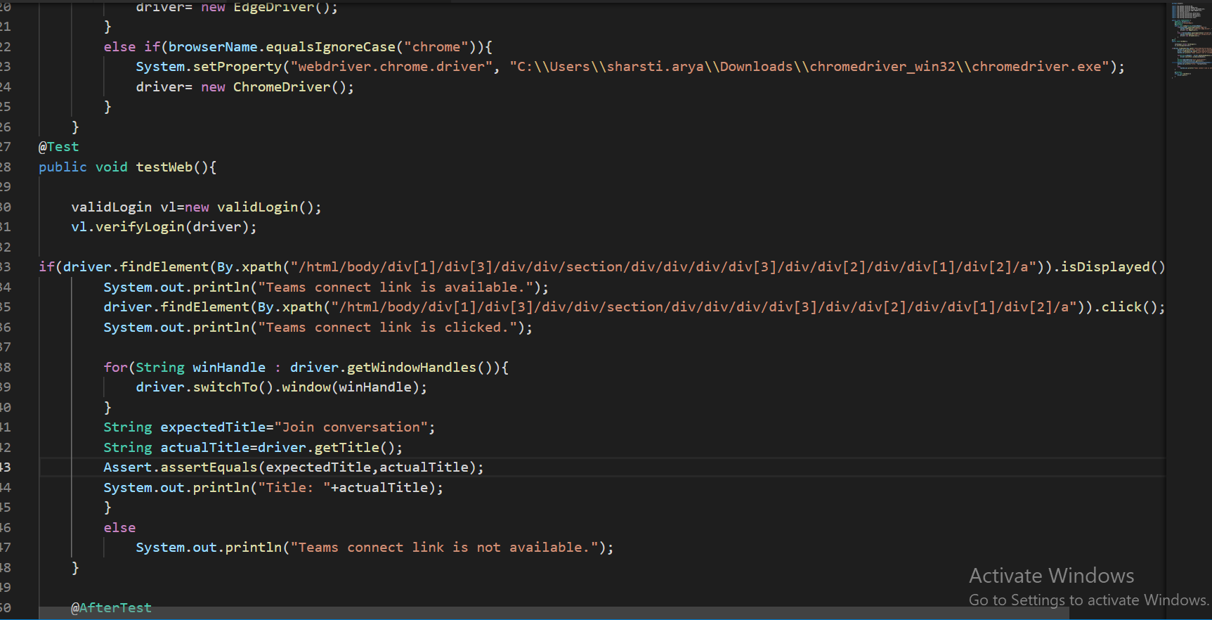

Slide 16


